Slide 1

Physical Chemistry
Ying Hu
(Fifth edition)
Bilingual Program
版权所有：华东理工大学物理化学教研室

Slide 2

7. Chemical Kinetics
Framework of the Chapter
  7.1 Introduction
  I. Fundamental Principles of Chemical Kinetics
  7.2 Rates of Chemical Reactions
  7.3 Reaction-Rate Equations
  7.4 Integrated Reaction-Rate Equations
  7.5 Opposite Reactions
  7.6 Consecutive Reactions
  7.7 Parallel Reactions
  7.8 Effect of Temperature on Reaction Rates

Slide 3

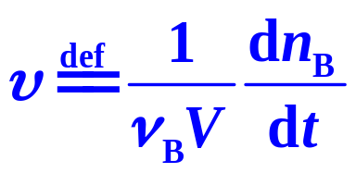
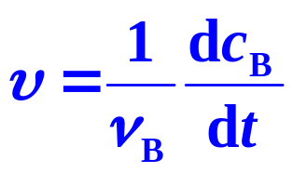
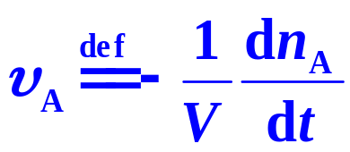
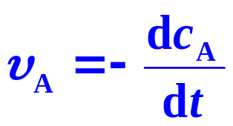
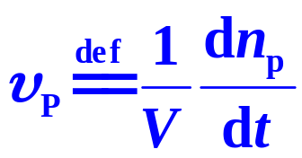
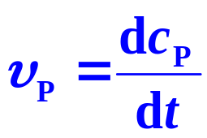
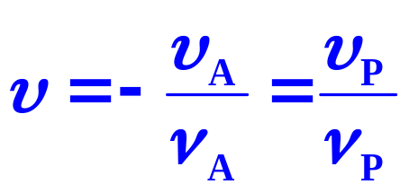
  7.2 Rates of Chemical Reactions
A P
Reaction Rate
Rate of Consumption
(V constant)
Rate of Formation

Slide 4

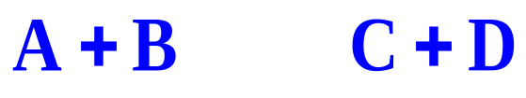
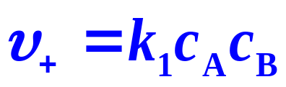
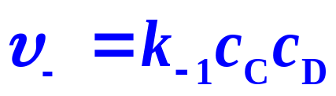
7.1 Introduction
Elementary Reactions
Products are formed by only one single step, no intermediates can be detected by macroscopic experimental methods
Mass Action Law
Reaction rate is proportional to the power product of concentrations of various reactants.

Slide 5


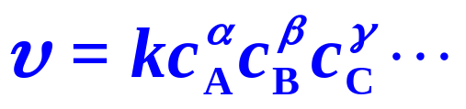

For a complex reaction
The rate equation is
In which, k is Rate Coefficient,
α, β, γ , are Partial Orders, the extents of influence of the substances on the reaction rate. They could be positive and negative, integers or non-integers.
n = α + β + γ +… , is Reaction Orders, The corresponding reaction is called a n^{th} -order reaction

Slide 6


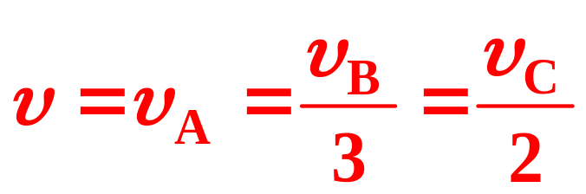
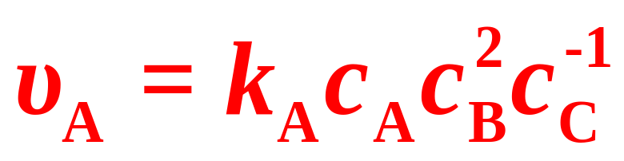
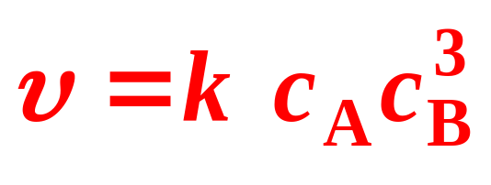
For the reaction of
For the element reaction of

Slide 7

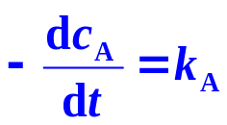

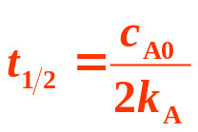


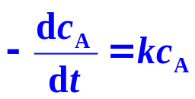
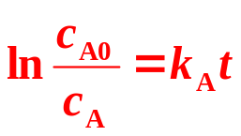

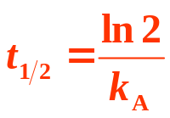

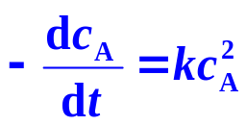
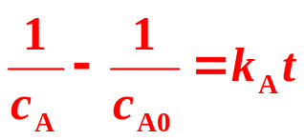
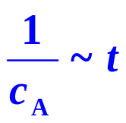
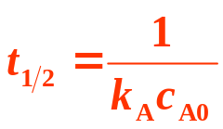

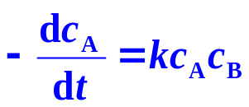
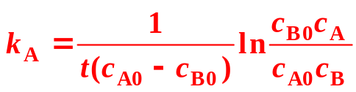
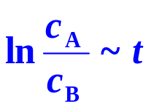
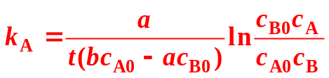

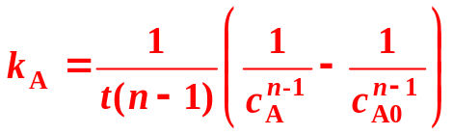

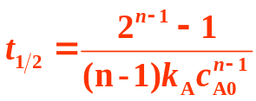

aA＋bB →P
Order | Rate equation |  | Characteristics
 | Differential | Integrated | Linear plotting | k_{A} Dimension | Half life t_{1/2}
0
n_{A}=1, n_{B}=0
n_{A}=2, n_{B}=0
n_{A}=1, n_{B}=1 a=b,c_{A0}≠c_{B0}
n_{A}=1, n_{B}=1 a ≠ b,c_{A0}≠c_{B0}
n

Slide 8
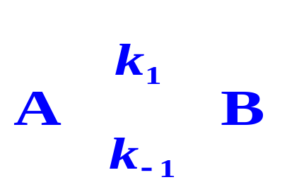

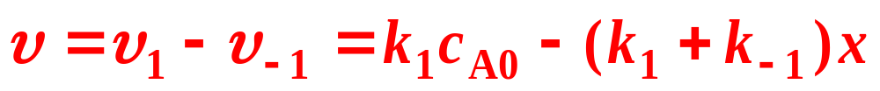
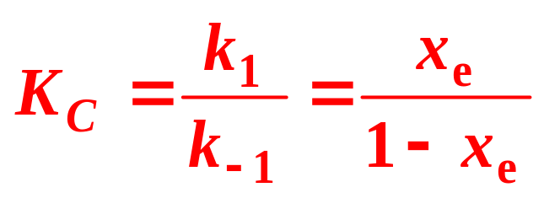
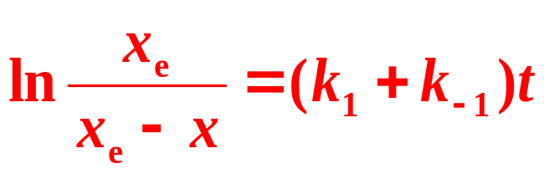
  For the first order opposite reactions
  the total reaction rate of A is
At equilibrium,
when c_{B} = x_{e}, c_{A}=c_{A0}−x_{e}, the integrated rate equation is

Slide 9
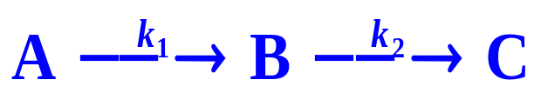
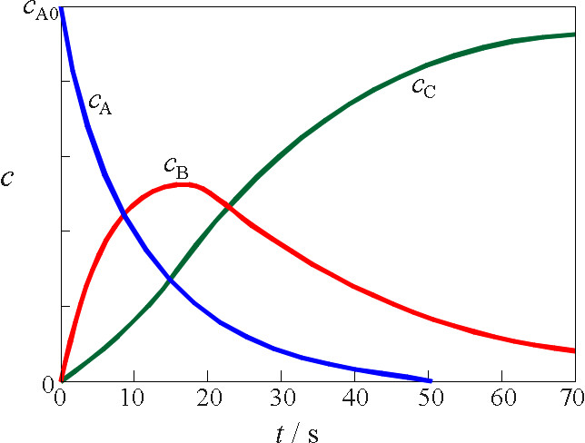

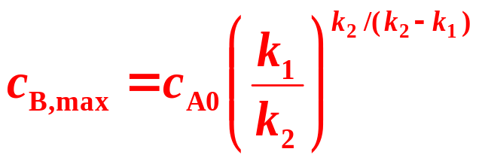
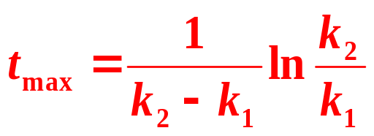
For the first order consecutive reactions
Remarkable peculiarity:
An appearance of a maximum of the c_{B}
If B is the favorable product, The maximum c_{B}, and the corresponding maximum time t_{max} are

Slide 10
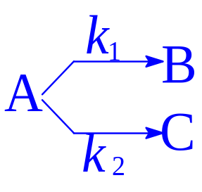
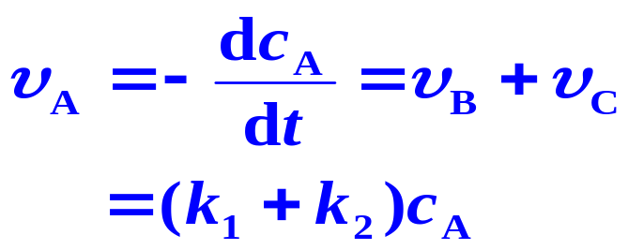
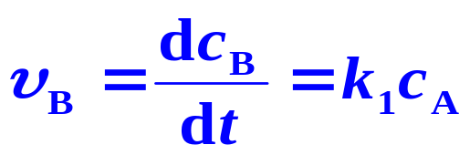
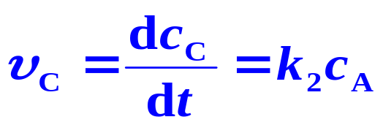
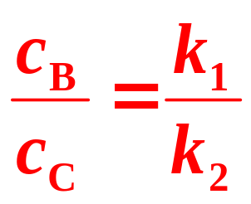
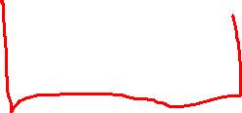
For a parallel reaction with the same reaction orders,
The ratio of the product concentrations is the same as the ratio of the reaction constants

Slide 11
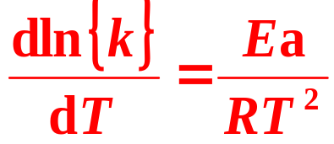
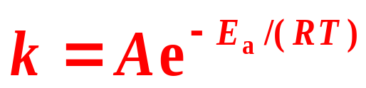

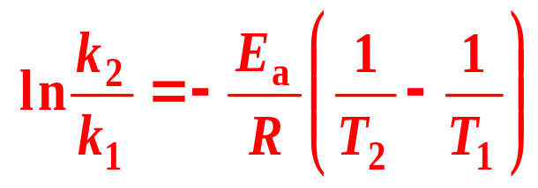
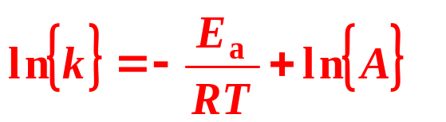
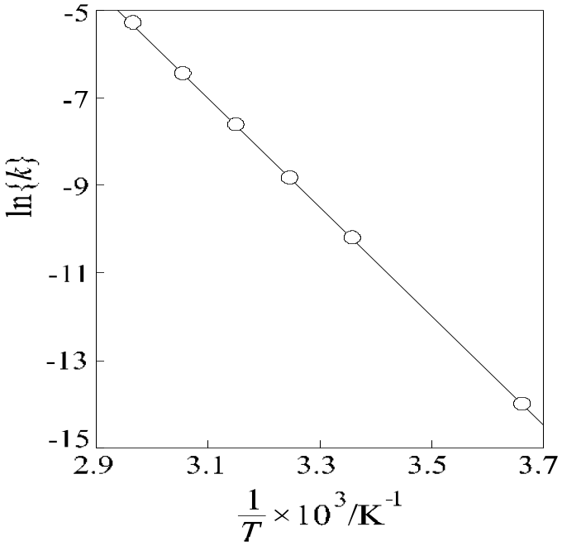
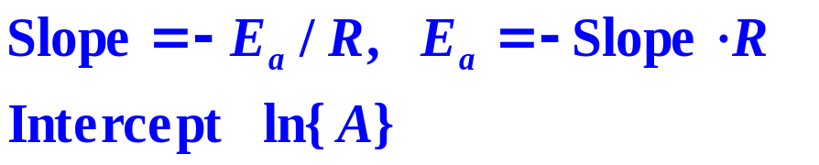
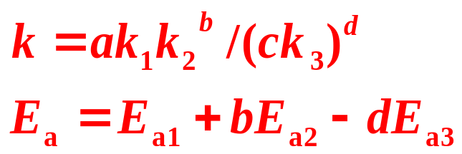
Arrhenius Equation
Activation energy Ea is a constant
The temperature dependence for the reaction rate.

